Slide 1
Beeswax Wraps
Sheryl Hoffmann
Notes:
Designed to replace single use plastic food wrap eg Clingwrap

Slide 2
BASIC RECIPE
Beeswax + Jojoba Oil + Tree Resin

Slide 3
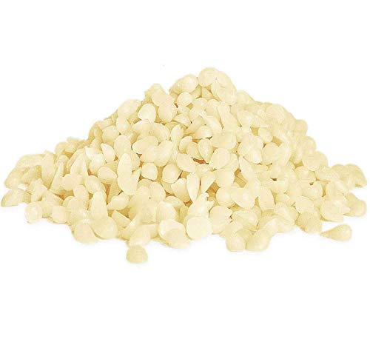
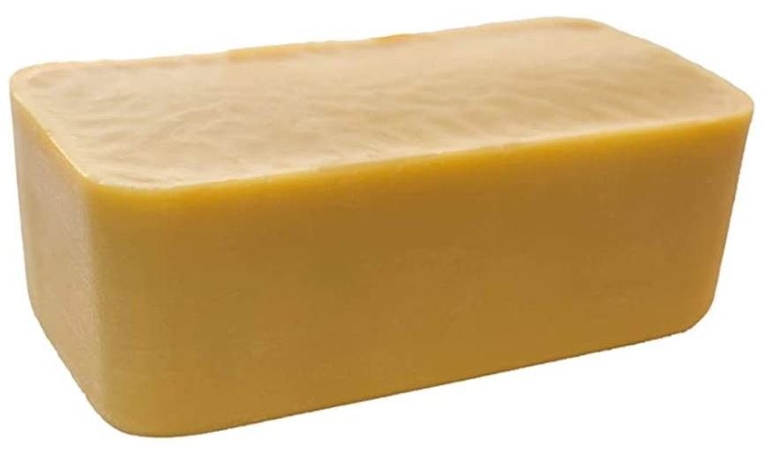
Beeswax
Natural Block
Bleached Pellets
Notes:
Bleached in sunlight on large trays. Can go even whiter than these pellets.
Natural colour darkens the fabric but can look good.
My samples are using bleached but we are using natural from Rianne’s beehive

Slide 4
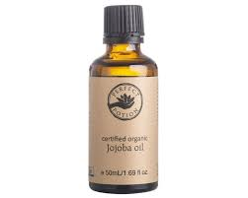
JOJOBA
Keeps coating soft and supple
Natural antibacterial oil that is also food safe

Slide 5
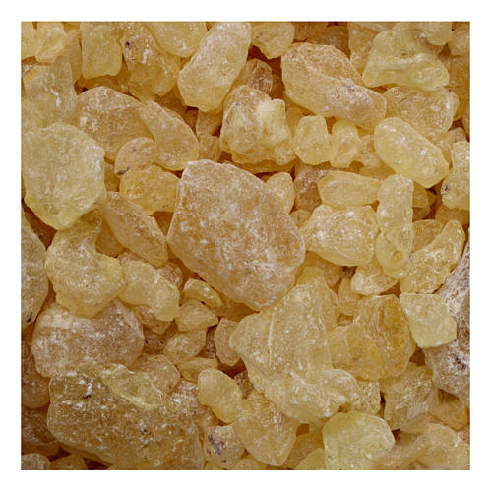
TREE RESIN
Gives a tackiness so it clings
Increases melting point of wax & makes it less brittle
Pine Resin/Rosin or Damar Resin
Notes:
Dammar Resin is used for a number of reasons
It raises the melting point of the beeswax and makes the wax less brittle for folding (this results in a beautiful wrap which can mould and hold its shape but not crack).
It is FDA approved for use in storage for food, as a glazing agent and as an additive in food.
Most importantly there are no known allergies and adverse reactions to Damar resin. There is a wealth of information about food additives and their long-term and acute effects and there have been no documented cases of dermatitis and asthma symptoms like there has been with Pine resin.

Slide 6
FABRIC
100% Cotton
Lightweight
Patterned is best
Washed and ironed
Notes:
Dark hides food stains but shows fold line

Slide 7
METHODS
Sprinkle individual ingredients on the cloth & bake
Paint mixture with a brush
Grate mixture & bake @ 100ºC
Iron grated mixture between baking paper
Notes:
Simple & does work but may not be even
Wax can harden on brush & need to re-melt. After painting can iron between baking paper sheets to spread evenly
Easiest Bake at <100oC (melts at 62-64oC, >85oC get disclourisation
Can user an iron instead of the oven but must work between baking paper & protect surface with blanket
Baking paper not compostable/recyclable (may be greener version)
Paper towel sticks to wax

Slide 8
BASIC RECIPE
200g Beeswax
20ml Jojoba Oil
20g Damar Resin
Notes:
The recipe that I found works best

Slide 9
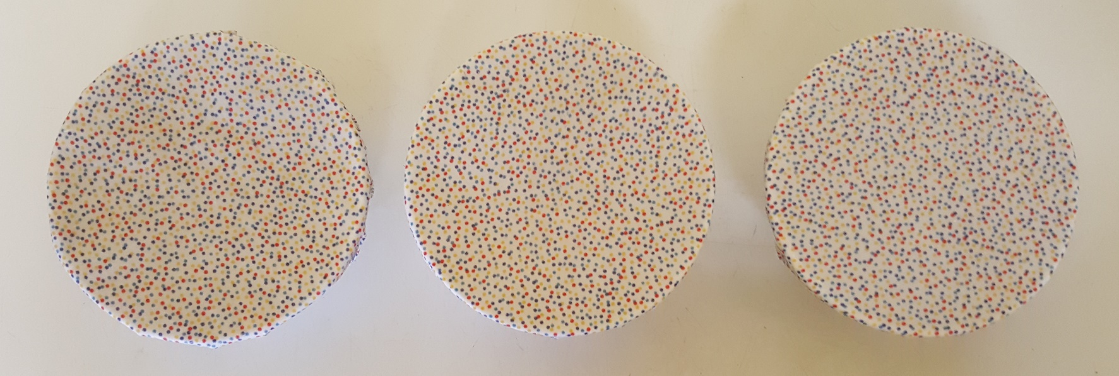
Comparison of 1-3 Ingredients
Notes:
Left: Beeswax only
Middle: Beeswax + Jojoba
Right: All three ingredients

Slide 10
Can make into wraps
Notes:
This is the first one I made & was an old sheet (probably poly cotton)
Hold in hands for 20 sec to soften to the wax to mold to shape of item

Slide 11
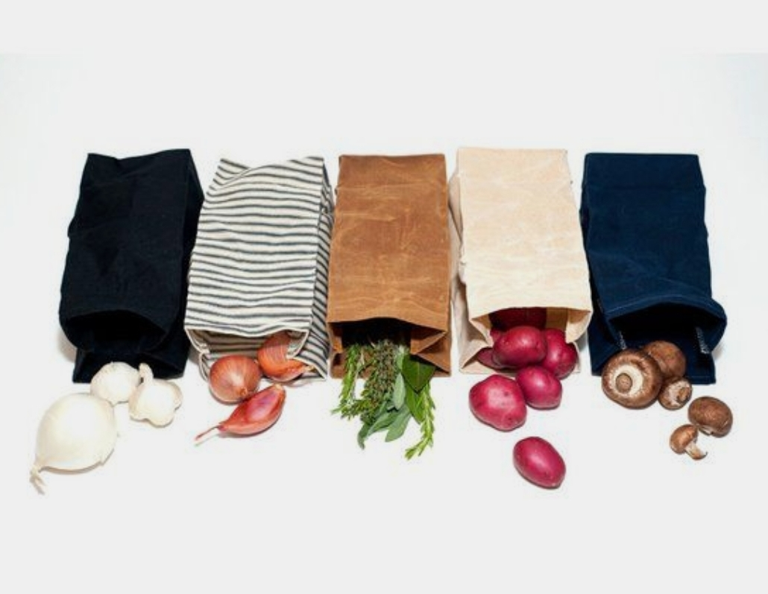
Can make into sandwich or lunch bags

Slide 12
Care of Beeswax wraps
To wash beeswax wraps, rinse the wrap with cool or lukewarm water and eco-friendly dish soap. You can use a cloth or sponge to wipe them down, then rinse off.
Once washed, the beeswax wraps need to air dry. We have a small clothing line in our kitchen to hang the wraps, but you can simply drape them over other drying dishes or even your faucet to dry.
Once dry, gently fold the beeswax wraps and store them in a drawer, basket or on a shelf.
Refreshing your wax wrap by reheating in the oven @ 100oC + add a little more wax.
Notes:
You don’t need to wring out the wrap.
Mould & bacteria killed @ 100oC
.

Slide 13
Do’s & Don’ts
Use to wrap food or cover containers
They will breathe so it will keep items for a few days, not weeks
Can be placed in the freezer
Keep away from all heat
Don’t put in dishwashers, microwave or oven
DON’T use the wraps to cover hot bowls or hot food.
Don’t use to wrap meat – it would then need heat to clean it properly
When no longer usable – put in compost bin
Notes:
.

Slide 14
Other Ways to Save on Plastic Wrap
Bread Bag
Produce Bag
Notes:
Just make sure they are 100% compostable eg cotton linen or hemp

Slide 15
Today’s Activity
Cut with pinking shears
Grate block of wax mixture
Sprinkle ~ 2 tbs onto fabric
Bake at 100oC until melted
Rearrange & resprinkle until all is covered
Hold until set
Notes:
Work in groups & learn from each other
Use potholder to remove from oven but fabric will be cool enough to touch with fingers
Clean up trays with paper towel while tray is still hot

