Slide 1
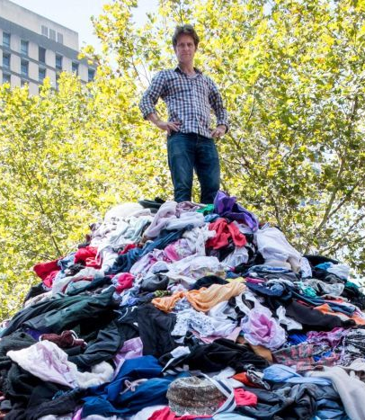
CLOTHING
Notes:
The average Australian throws away 23kg of clothing per year.
= 6 tonne every 10 mins in Australia = (Craig Recassel in Martin Place (ABC radio announcer) ) & presenter of “War on Waste”)
We purchase 5X the amount of clothing as 25 years ago
Much is cheap & poorly made. Most are synthetic & end up in landfill.

Slide 2
Recent Quote
“I absolutely loved the feeling of buying something new. Having a new outfit to wear out with friends gave me such a high. It was a temporary source of happiness and I felt richer than I actually was.”
“But that’s exactly what it was – I was creating a false sense of wealth that came through cheap and easy consumption”.

Slide 3
Rethink, Reduce, Reuse & Recycle
rethink our wardrobes
reduce what we purchase
purchase quality not quantity
purchase ethically & sustainably
purchase secondhand
learn to sew
repair, remake & reuse clothing
recycle as a last resort
Notes:
Old jumper made into a handbag
Make rag rug
3 years ago, I decided not to buy any new clothing for 12 months - I learned that it was easy, I didn’t miss it. Nobody has made a comment! Give it a try.
For the next 12 months I only replaced worn out items. eg shoes
The third year I thought very carefully before I purchased anything, thinking of long-term needs (not wants) as I look to retiring in 2 years time.

Slide 4
Notes:
But need to know what the fabric is made from, to know if it is recyclable or compostable
And, how to wash & care for item with minimal impact.
Microplastic pollution, in part, comes from washing & wearing clothing – only wash when needed
To compost clothing remove all zips, seams, buttons etc & cut into palm sized pieces

Slide 5
Recycling Clothing & Shoes
Nike - In Australia, there are Nike Reuse-A-Shoe bins located at Rebel Sports Stores.
Work boots - Total Workwear stores
Clothing retailers H&M, Zara and Manrags each have garment collection programs for clothing or textiles, which they reuse or recycle.
Notes:
Hopefully this will improve as more people become aware & companies become better at it

Slide 6
Materials such as clothes, sheets and towels of any colour or condition are turned back into high value raw materials of PET and Cellulose.
Notes:
New Companies are springing up. Watch for further examples
Blocktexx a Brisbane Co, going into full scale this year
The recovered PET is polymerised to create virgin-quality S.O.F.T. branded rPET plastic pellets and polyester fibre suitable for use in textiles, packaging, building products.
The recovered cellulose is processed to create S.O.F.T. branded cellulose powder for use in many industries such as textile, pharmaceutical and food.

Slide 7
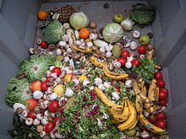
FOOD WASTE
Notes:
]

Slide 8
Definition
Food waste is food that is not eaten. The causes of food waste or loss are numerous and occur at all stages of production, processing, retail and consumption.
Global food loss and waste amount to between one-third and one-half of all food produced. Loss and wastage occur at all stages of the food supply chain or value chain. In low-income countries, most loss occurs during production, while in developed countries much food – about 100 kilograms (220 lb) per person per year – is wasted at the consumption stage.
Notes:
To reduce food waste:
Plan meals
Go shopping with a list
Regularly check the fridge
Freeze leftovers
Preserve home grown fruit & vegies
Pickling is fun & currently in fashion
Compost any food waste - never put in landfill

Slide 9
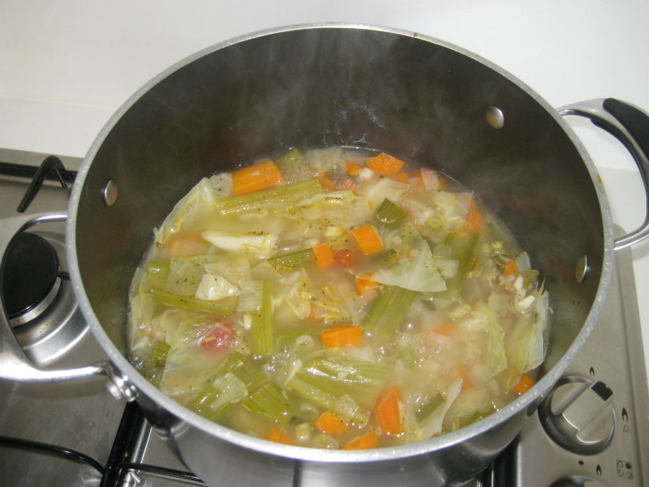
Keep vegetable peels to make stock

Slide 10
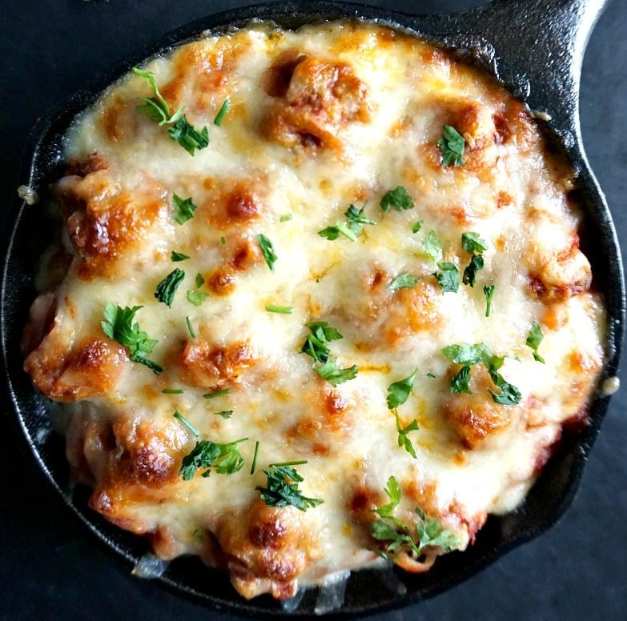
Freeze cheese bits for toppings
Notes:
Big blocks of cheese may be cheaper, cut in half & freeze

Slide 11
Food Waste Dumpster Diving
Notes:
Ozharvest – Ronni Kahn’s book “A Repurposed Life”
Food bank - sourcing and rescuing food for its networks of 2,600 charity partners and 2,500 schools.
Many stores throw out good food, especially if use-by date is 2 – 3 days away.
Don’t search shelf for longest use-by date if you are going to eat it on the same day.

Slide 12
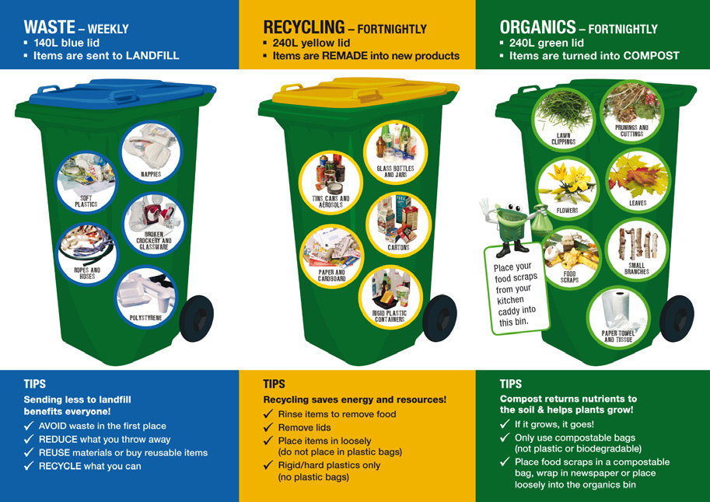
Recycling - Which Bin?
Notes:
Some councils have different colour lids.
Each Council will have their own list of what goes where & rules of do’s & don’ts. Check out their website

Slide 13
No Wishcycling
Wishcycling is putting something in the recycling bin and hoping it will be recycled, even if there is little evidence to confirm this assumption.
Notes:
Learn what can be recycled & what can’t.
High quality recycling not contaminants.

Slide 14
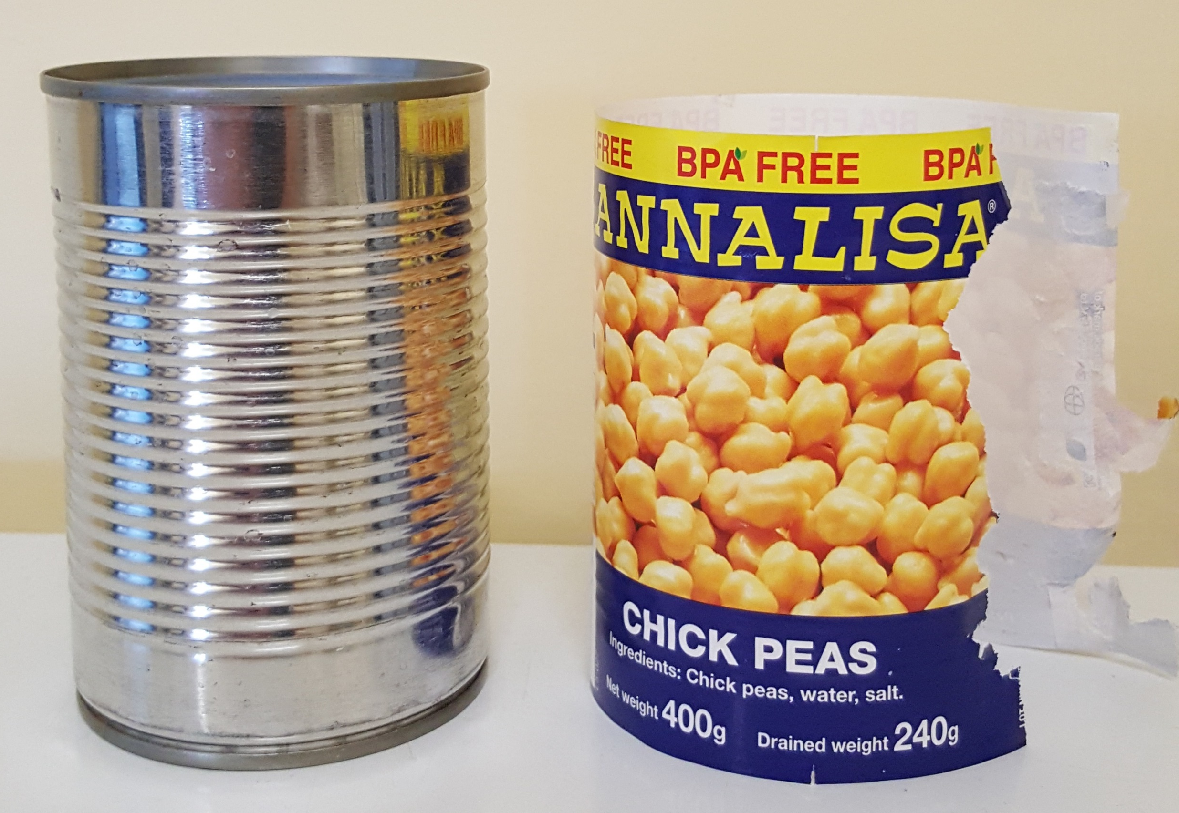
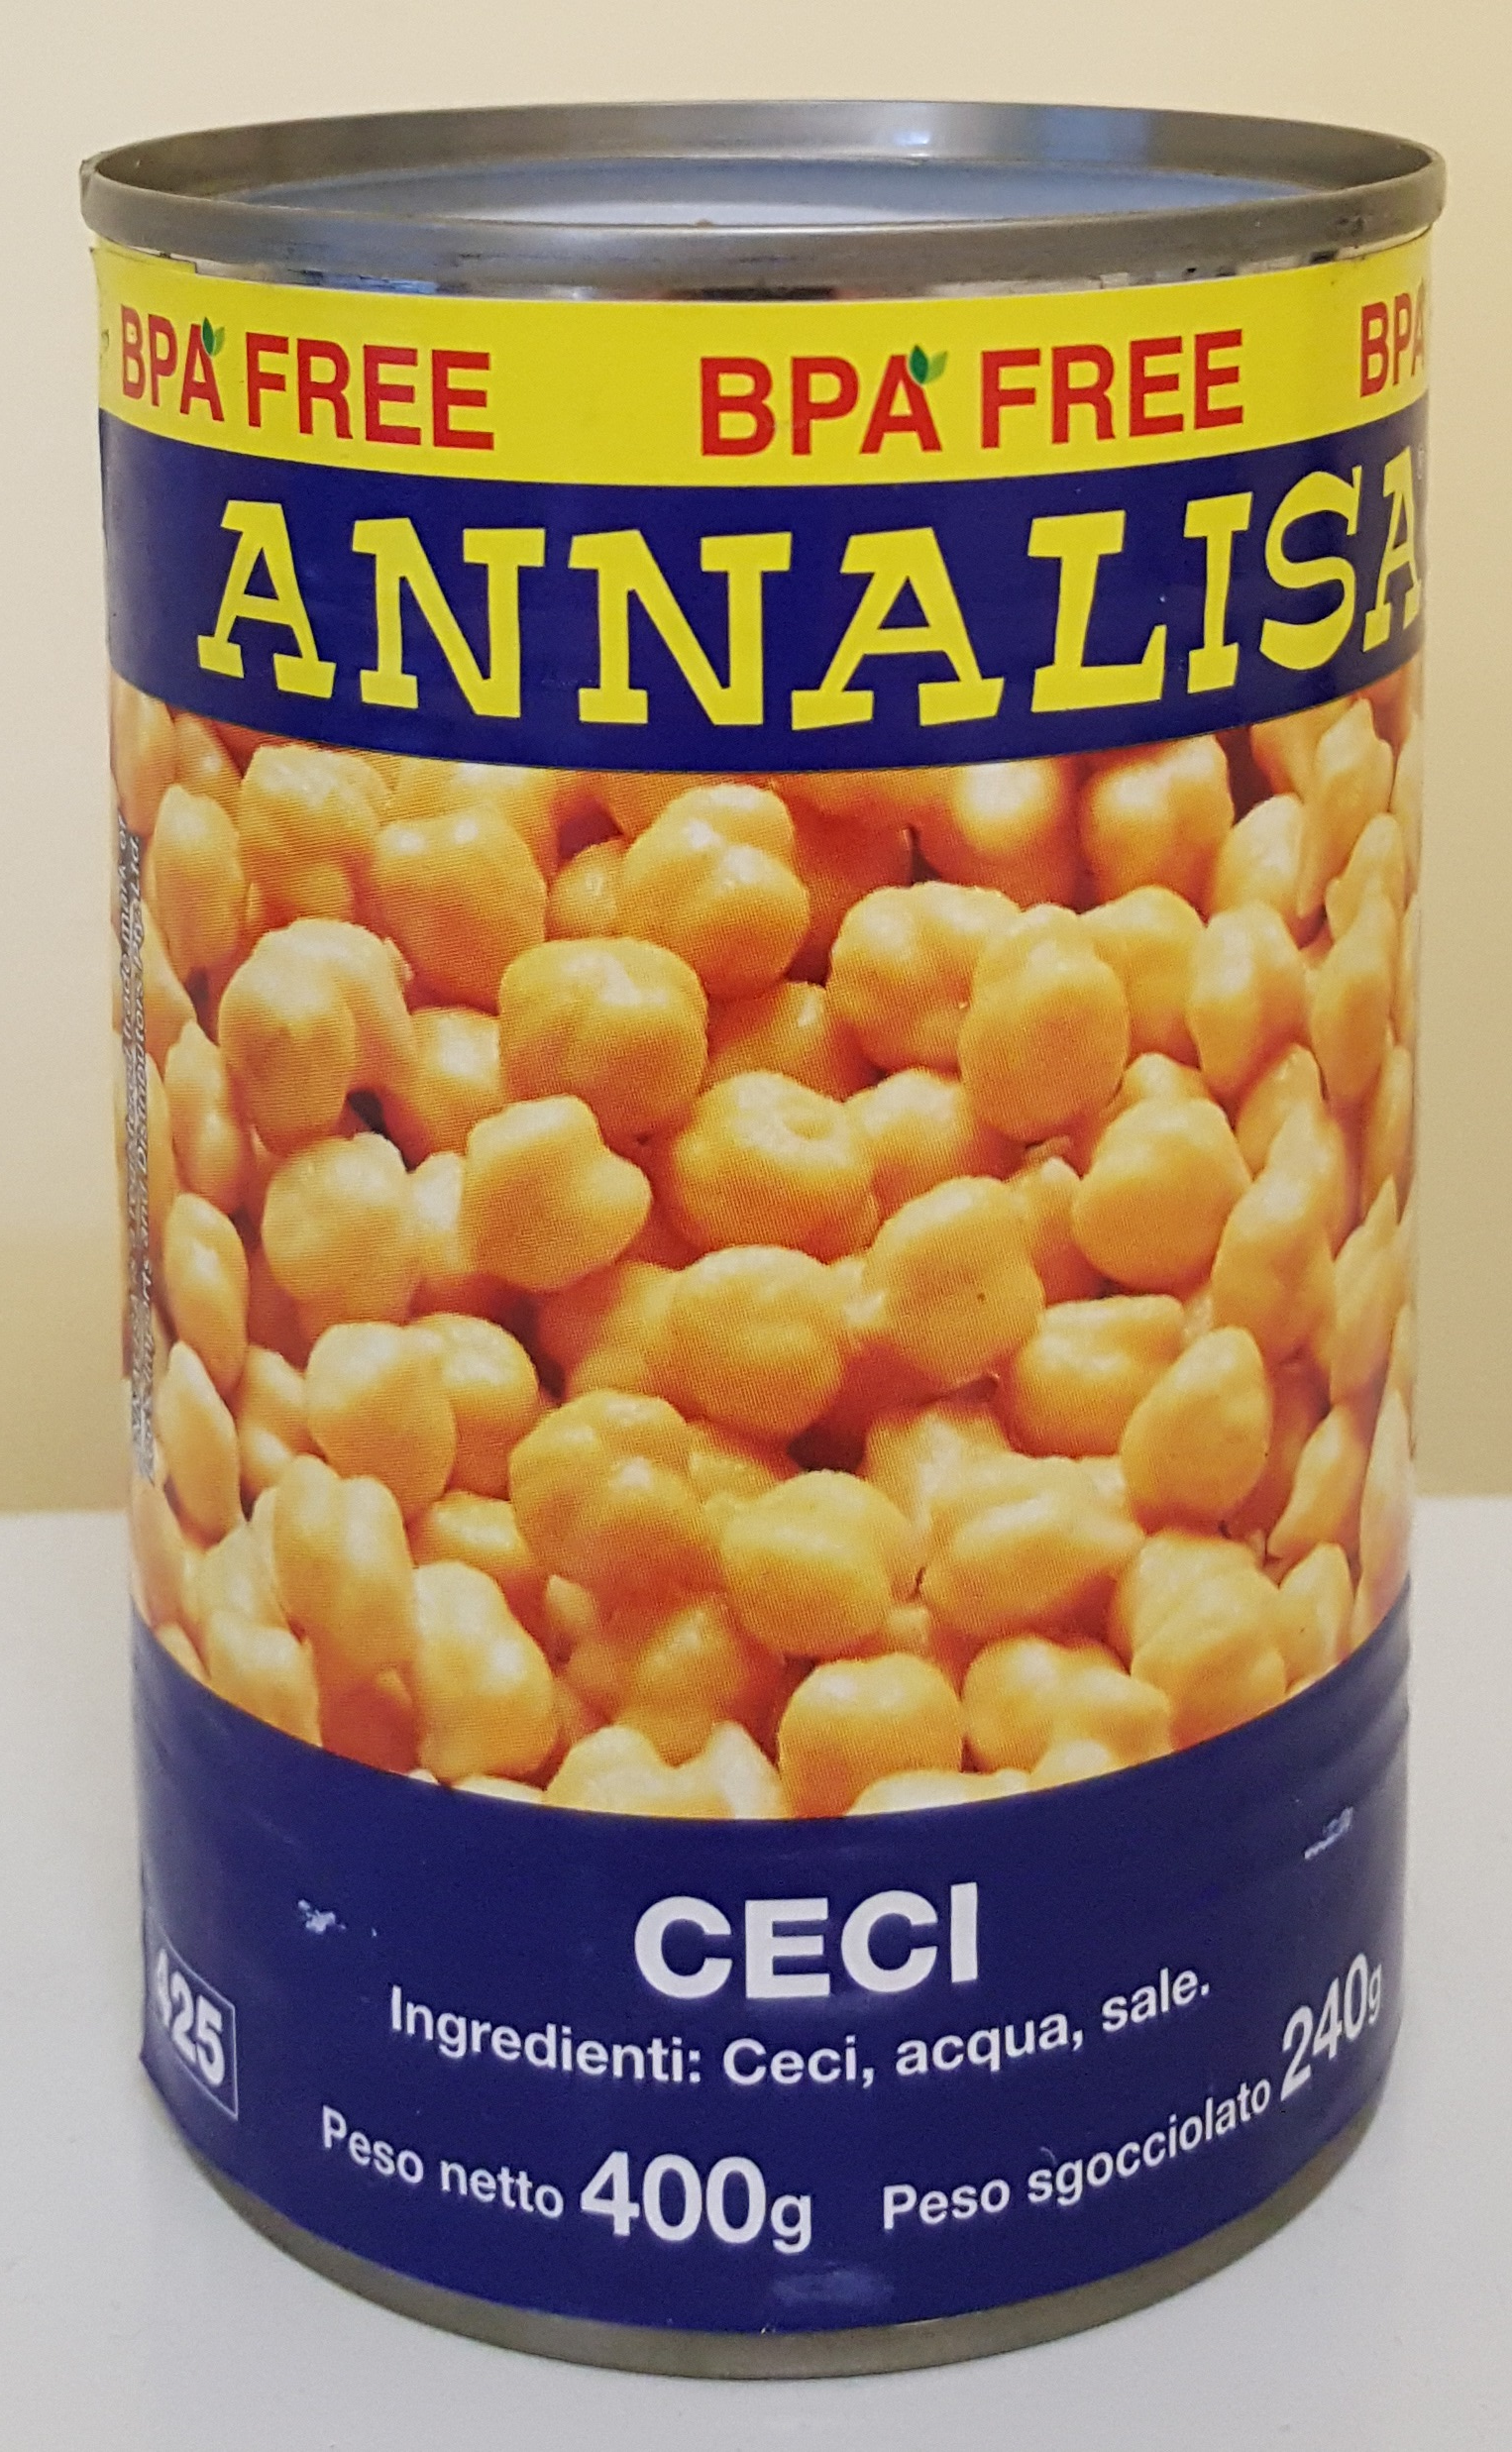
High Quality Recycling Takes Effort
Good
Better
Notes:
Separating paper from metal can means both products can be recycled

Slide 15
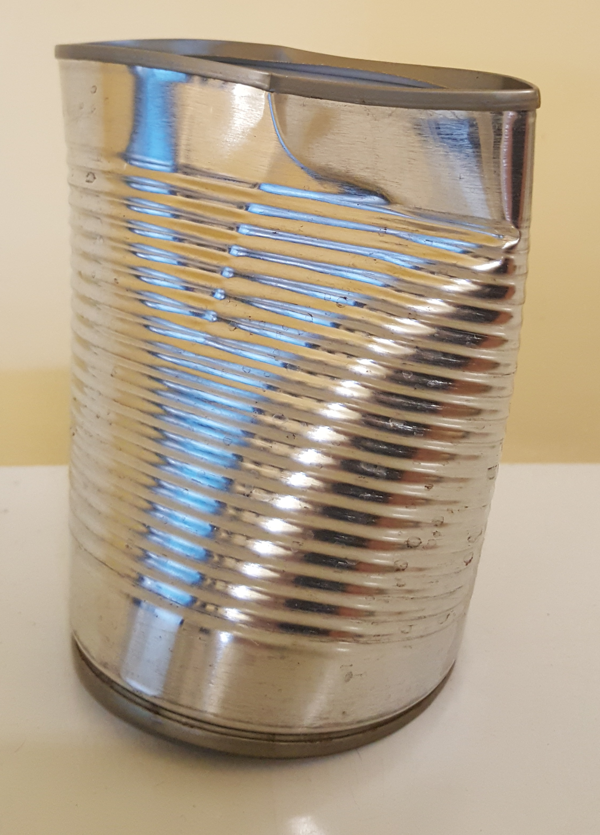
High Quality Recycling Takes Effort
Notes:
Add lid (+ wine bottle lids) to container & squash

Slide 16
High Quality Recycling – Pizza Box
Clean lid into Paper Recycling bin
Greasy bottom into Organics bin

Slide 17
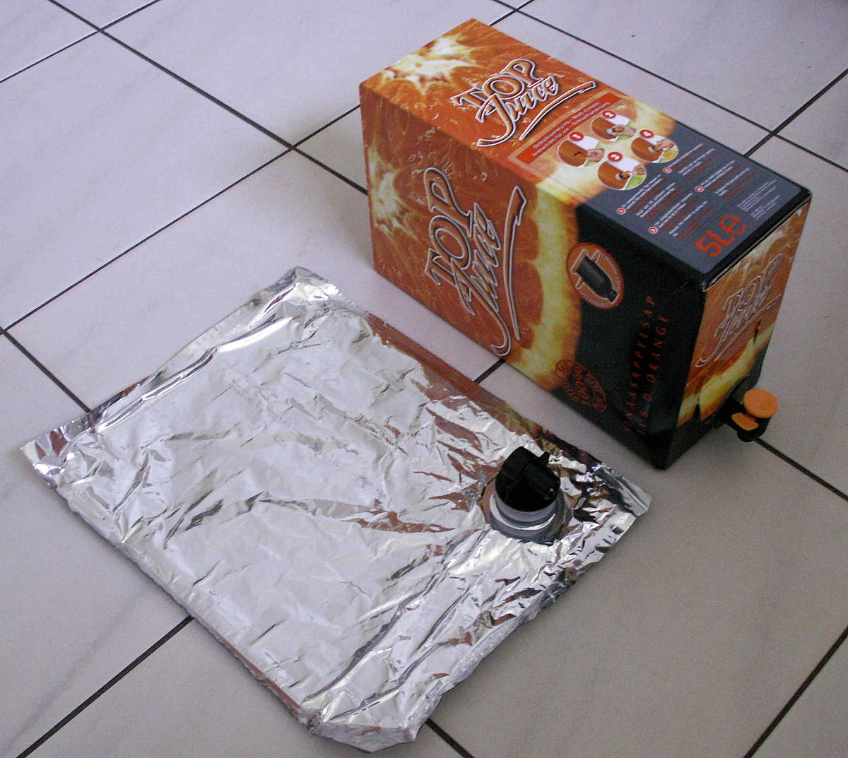
High Quality Recycling Takes Effort
4 parts to a wine bladder
Carton (recyclable)
Spout (hard plastic)
Silver Outer (waste)
Clear inner (soft plastic)
Notes:
Wine Bladder – cut spout off (hard plastic)+ clear spot plastic (soft plastic)+ silver plastic (waste)
Silver outer is metalized plastic which we can’t currently recycle

Slide 18
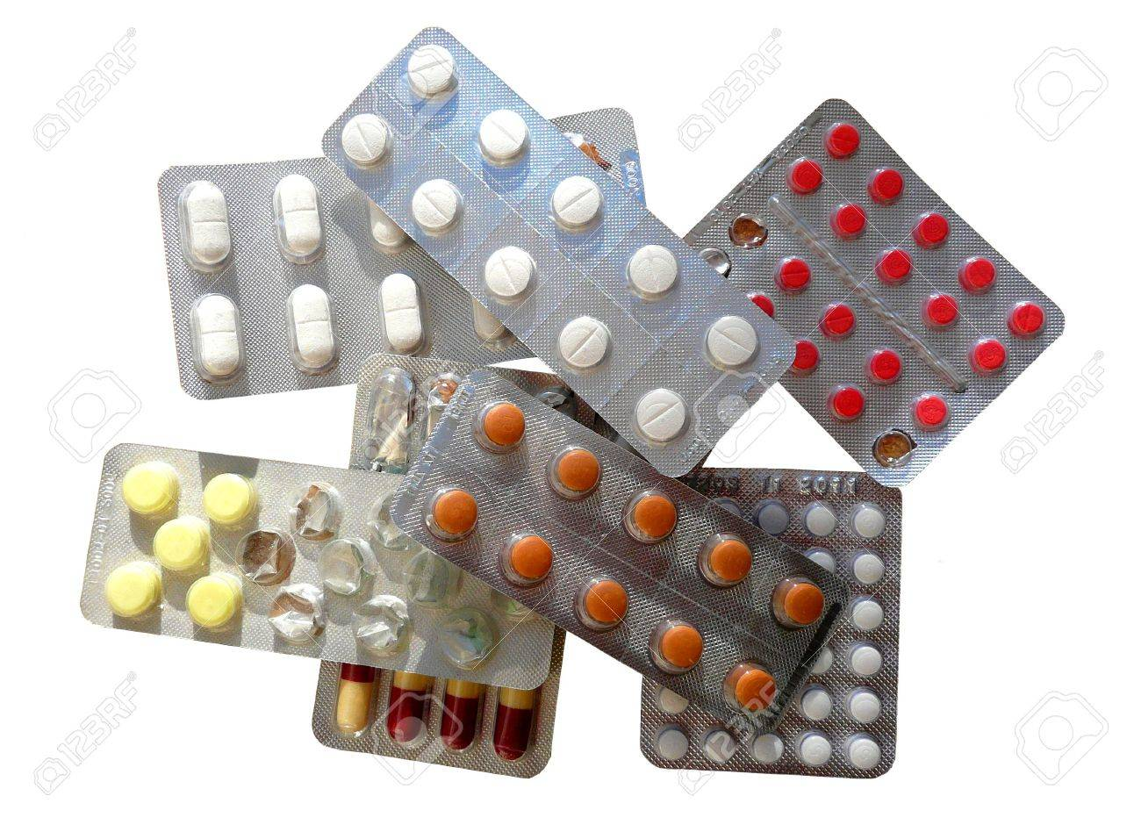
High Quality Recycling - Medication
Notes:
Expired medication to Pharmacy – never down the toilet or in rubbish bin
Foil & plastic closely combined is not recyclable BUT the foil can be pulled off & wrapped in used foil

Slide 19
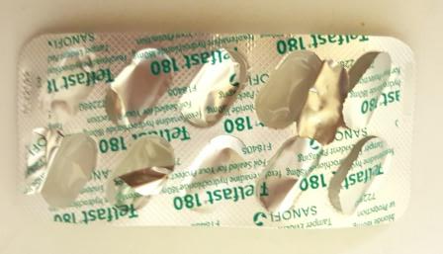
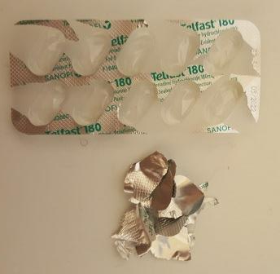
Recycling Foil
Notes:
Wrap in a larger sheet of used foil & throw in recycle council bin when size of a fist
You will be surprised how it adds up

