Slide 1
Tricky Recycling
COOLFOAM
Notes:
Electronic Recycling Aust - Underdale
Unplug and Drop – Bunnings etc
Coolfoam – polystyrene foam - Edinburgh North
Tech Collect – electronic waste
Mobile Muster – post office
Officeworks – pens & textas, mobiles, ink cartridges
Green Industries – household chemical waste, pesticides & paint & fluros
Cartridges for Planet Ark – post office
Paintback – paints & motor oil

Slide 2
Summary

Slide 3
Resources
https://sherylhoffmann.weebly.com/
Tab: Other Resources

Slide 4
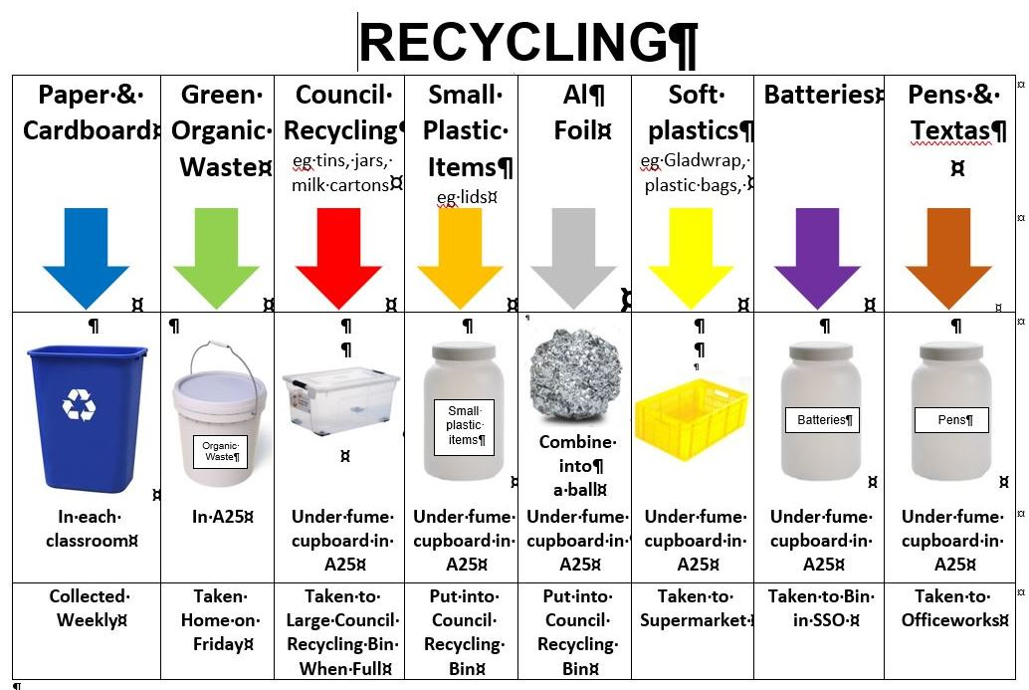
Notes:
What do other schools do?
Any good tips to help save the planet?

Slide 6
Final Comment

