Slide 1
The Second “S” in STEMS - Sustainability
LMASA Annual Conference 2022
By Sheryl Hoffmann
Notes:
We all know about STEM but we need to include a second “S” - Sustainability
I started seriously trying to reduce my plastic usage & to recycle everything possible about 3 years ago.
So, this talk is about what I have learned during that time.
This talk was going to happen 2 years ago but COVID got in the way.

Slide 2
Contents
Why?
Ecological Footprint
The Australian Curriculum
5 “R’s” in Responsible Disposal
Plastics
Clothing
Food Waste
How to recycle
Resources
Notes:
This workshop will introduce terminology, ideas & resources to get started, rather than anything in depth.
Start from basics ie assume that you don’t know anything

Slide 3
Greenland is melting at an alarming rate
Notes:
I was lucky that in 2018, I went to Greenland & to the UNESCO World Heritage Centre Icefjords near Ilulissat 250km above the Arctic Circle.
It was so stunningly beautiful that to think it may all melt is heart wrenching.
Glaciers world-wide are retreating & we are getting to nearly 50oC in Siberia
The Antarctic is melting too!

Slide 4
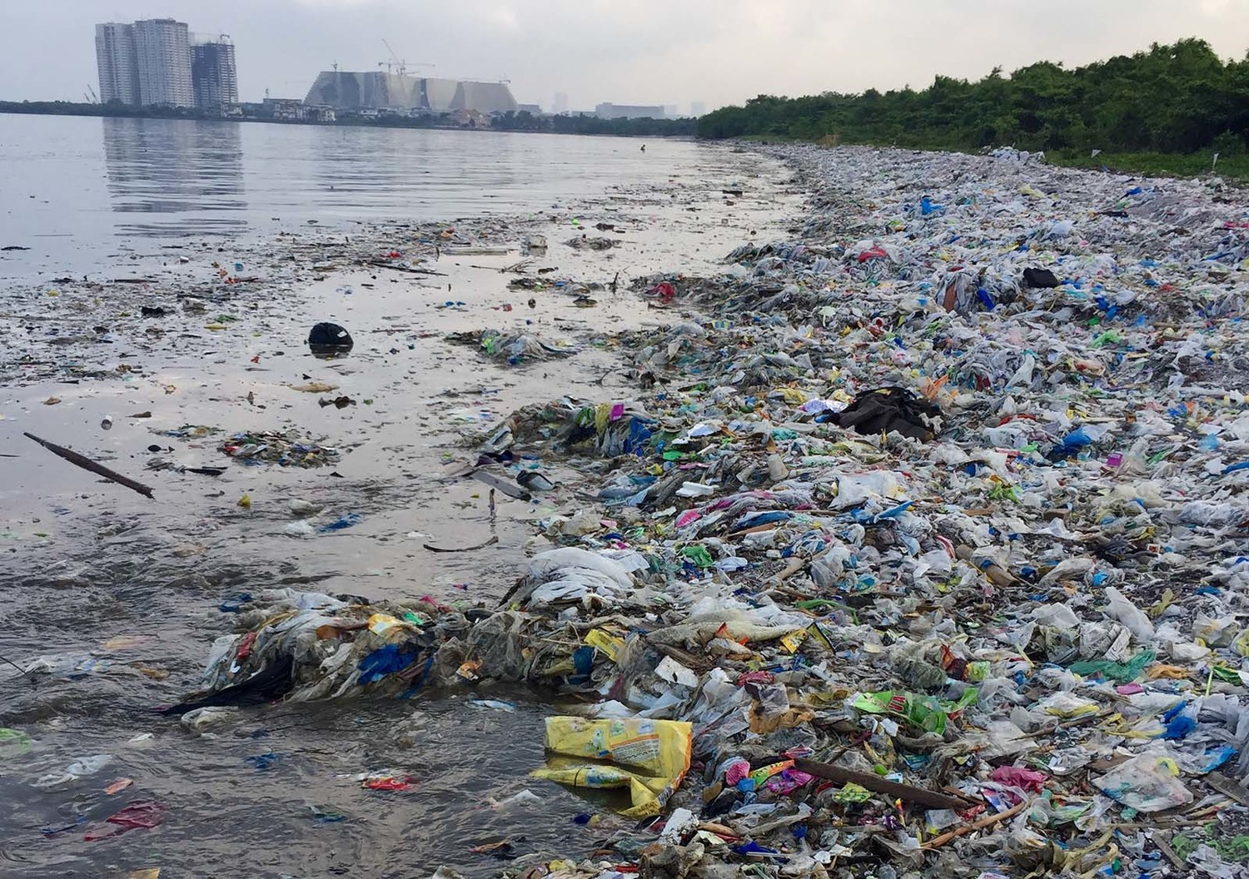
The planet is drowning in Waste
Notes:
Previously pristine areas are covered in waste much of it is single use plastic

Slide 5
Consumerism is running rampant
Consumerism refers to the theory that spending money and consuming goods is good for the economy.
Opponents of consumerism suggest simple living is a more sustainable lifestyle and better for the environment.
Notes:
planned obsolescence and advertising to manipulate consumer spending.
Materialism is a personal attitude which attaches importance to acquiring and consuming material goods.
globalization
Mass production
We are currently in a society where convenience, cost, accessibility and time management is more important than the health of the planet that’s keeping us afloat. It is ingrained in everything we produce, and everything we consume.

Slide 6
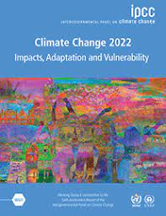
Intergovernmental Panel on Climate Change
The United Nations body for assessing the science related to climate change.
“Climate change is affecting nature, people’s lives and infrastructure everywhere. Its dangerous and pervasive impacts are increasingly evident in every region of our world. These impacts are hindering efforts to meet basic human needs and they threaten sustainable development across the globe. ”
Notes:
Report released every 4 years.
Several working parties & several reports.
2021/2022 6th Report
Previous reports
“CC may be man-made.”
“Yes - it is man-made”

Slide 7
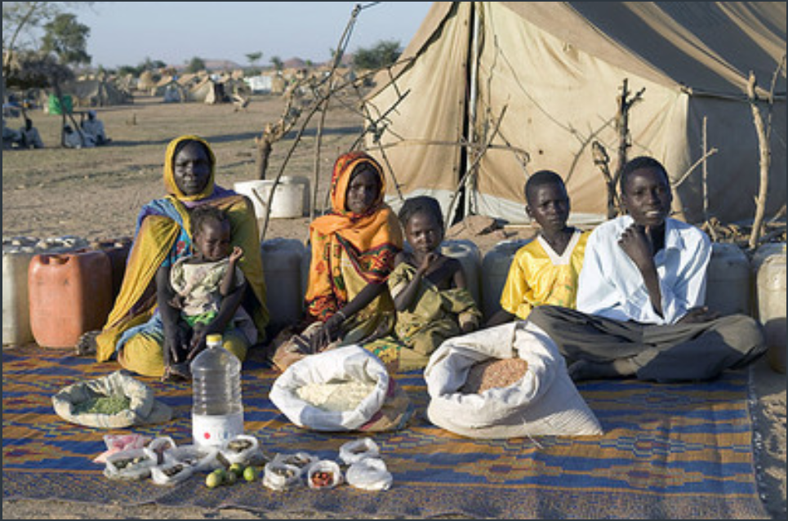
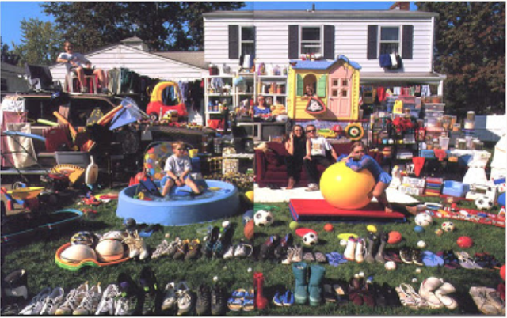
Everything You Own In A Photo: A Look At Our Worldly Possessions
Material World: A Global Family Portrait by Peter Menzel
Notes:
Inequality is increasing
The rich are getting richer

Slide 8
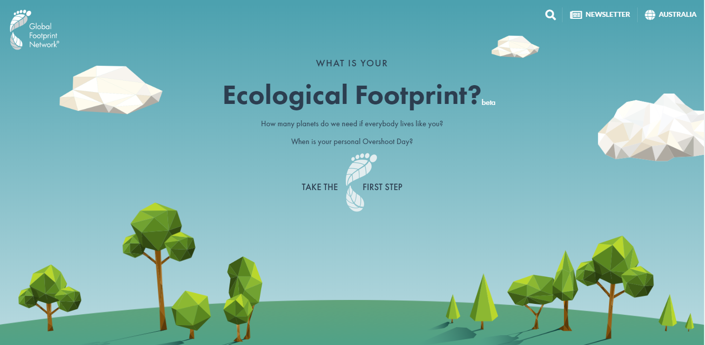
Ecological Footprint
https://www.wwf.org.au/get-involved/change-the-way-you-live/ecological-footprint-calculator#gs.yh1hfw
Notes:
The Ecological Footprint is the area of biologically productive land and water needed to provide ecological resources and services – food, fibre, and timber, land on which to build, and land to absorb carbon dioxide (CO₂) released by burning fossil fuels for an individual.
Try the calculator yourself to see how many worlds would be needed if everyone lived like you.

Slide 9
Australian Curriculum
Notes:
Sustainability is a cross curriculum priority just like aboriginal culture

Slide 10
Australian Curriculum
Science
In the Australian Curriculum: Science, the Sustainability priority provides contexts for investigating and understanding chemical, biological, physical and Earth and space systems. Students explore a wide range of systems that operate at different time and spatial scales. By investigating the relationships between systems and system components and how systems respond to change, students develop an appreciation for the interconnectedness of Earth’s biosphere, geosphere, hydrosphere and atmosphere. Relationships including cycles and cause and effect are explored, and students develop observation and analysis skills to examine these relationships in the world around them. In this learning area, students appreciate that science provides the basis for decision-making in many areas of society and that these decisions can impact on the Earth system. They understand the importance of using science to predict possible effects of human and other activity and to develop management plans or alternative technologies that minimise these effects.

Slide 11
Sustainability
The ecological definition of sustainability originated with the Brundtland Report in 1987, which describes sustainable development as one that satisfies the needs of the present without adversely affecting the conditions for future generations.

Slide 12
Currently we don’t have Sustainability
Effectively, the Earth’s regenerative capacity can no longer keep up with demand.
People are turning resources into waste, faster than nature can turn waste back into resources.
We need to think sustainability not consumerism.
Notes:
What is the solution?

Slide 13
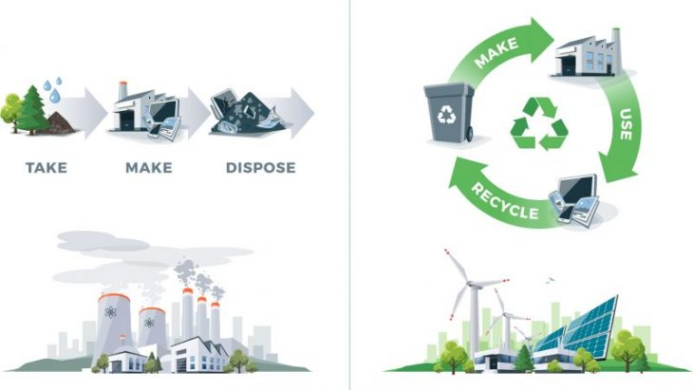
Circular Economy
Notes:
Circular economy vs consumerism

Slide 14
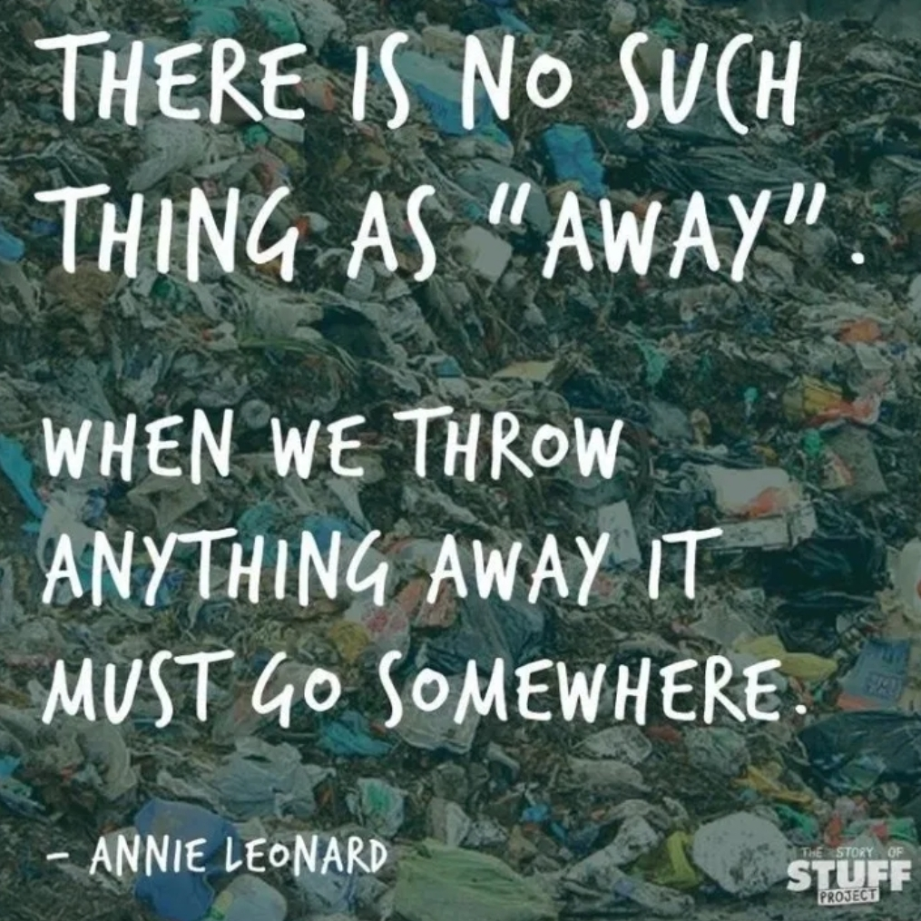
Notes:
We are running out of SOMEWHERE

Slide 15
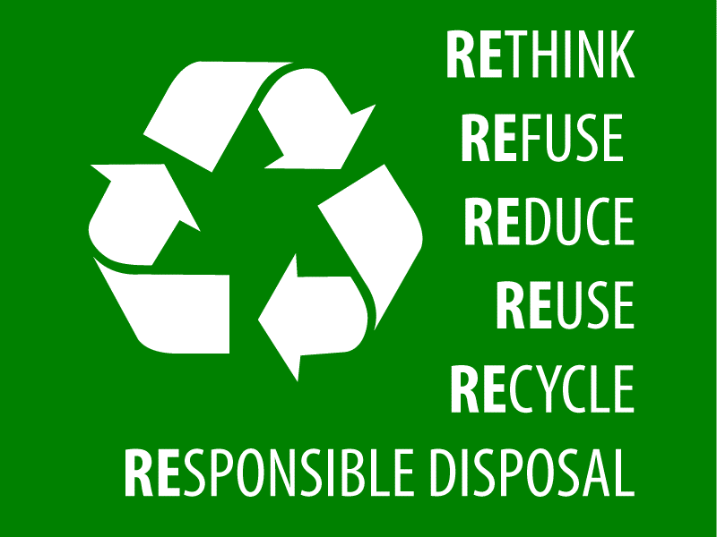
5 R’s of Responsible Disposal
Rethink our purchases
Refuse over packaging
Reduce what we purchase
purchase quality not quantity
purchase ethically & sustainably
purchase secondhand
Reuse, refill, repair, remake or repurpose
Recycle as a last resort
Rot
Notes:
Recycling is way down the list of things we should do
Don’t buy single-use items
Live more like your grandparent’s lived. (Through the great depression)

Slide 16
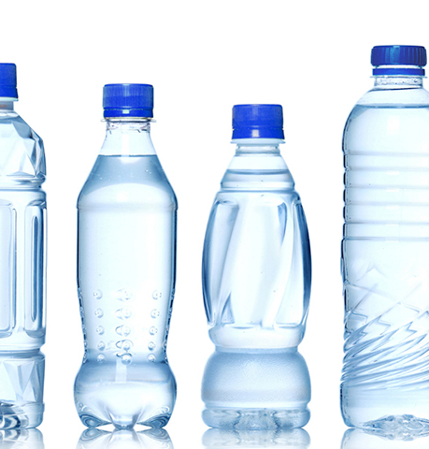
PLASTICS
Notes:
PET = Polyester
PET, which stands for polyethylene terephthalate, is a form of polyester (just like the clothing fabric).
Not biodegradable + -> microplastics

Slide 17
Greenwashing
Notes:
Greenwashing giving a false impression or providing misleading information about how a company's products are environmentally sound.
Greenwashing unsubstantiated claims to deceive consumers into believing that a company's products are environmentally friendly.
Lego now using recycled plastic & saying they are environmentally friendly – ??

Slide 18
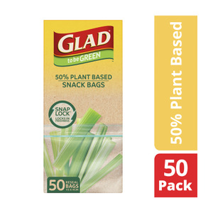
Example of Greenwashing
Notes:
If you go down the plastic bag & wraps isle you will be surprised how many of the products have green pictures or writing.
50% plant based = made from sugar cane but now it is plastic & will last 1,000 years
Bags that are produced from sugar cane - a renewable resource. By replacing a portion of fossil fuel plastic with bio-based plastic, these food bags have a smaller carbon footprint.
Made from 50% renewably sourced material Packaging is made from 70% recycled content and is 100% recyclable.
Glad Snap Lock Bags are recyclable through the REDcycle program in Australia.
Yes, not using oil but is using farmland that could grow food - NOT GREEN

Slide 19
Definitions
plastic means a material made from, or comprising, organic polymers, whether plant extracts or of fossil fuel origin;
Bioplastics = plastics produced from renewable biomass sources, such as vegetable fats and oils, corn starch, straw, woodchips, sawdust, recycled food waste, agricultural by-products etc (some definitions include petroleum-based plastics too!)
Compostable = is capable of disintegrating into natural elements in a compost environment, leaving no toxicity in the soil. Ex Biobags
Notes:
All these definitions are rubbery & depend on who is using them!
"bioplastic" are not necessarily compostable
differentiate between home and commercial (industrial) composting – deferent Australian Standards

Slide 20
Definitions
Degradable Plastic: A plastic designed to undergo a significant change in its chemical structure under specific environmental conditions resulting in a loss of some properties that may vary as measured by standard test methods appropriate to the plastic and the application in a period of time that determines its classification.
Biodegradable Plastic: A degradable plastic in which the degradation results from the action of naturally-occurring micro-organisms such as bacteria, fungi, and algae.
EPI Plastic Totally Degradable Plastic Additives (TDPA™) that assists plastic to break down more quickly
Notes:
EPI Plastic Under U.S. laws, products with EPI’s additives may not be biodegradable or compostable, depending on the conditions of disposal and the specific product.
EPI plastic is not recyclable with soft plastics because it may start to break down

Slide 21
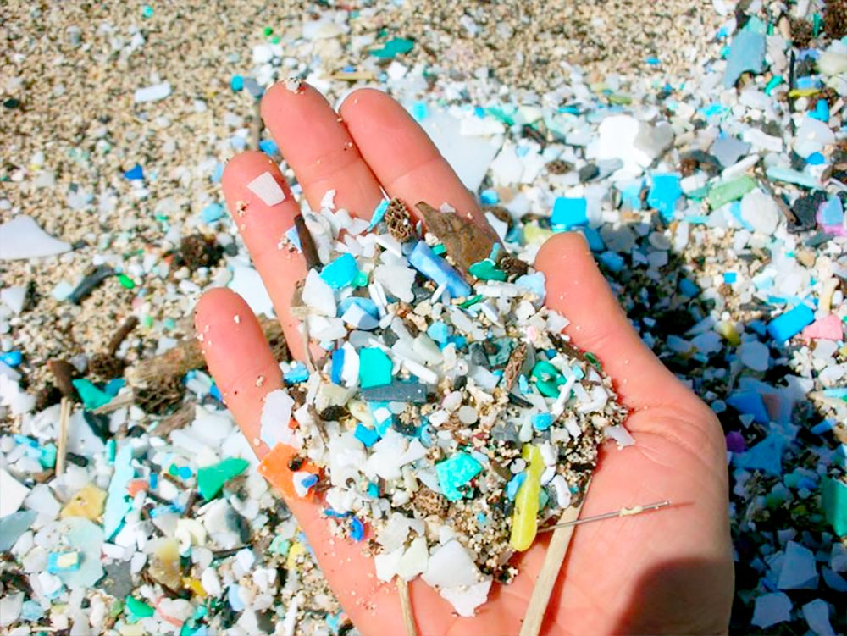
Definitions
Microplastics - fragments that are less than 5 mm ie extremely small pieces of plastic debris in the environment resulting from the disposal and breakdown of consumer products and industrial waste.
Notes:
Killing marine life & contaminating the earth

Slide 22
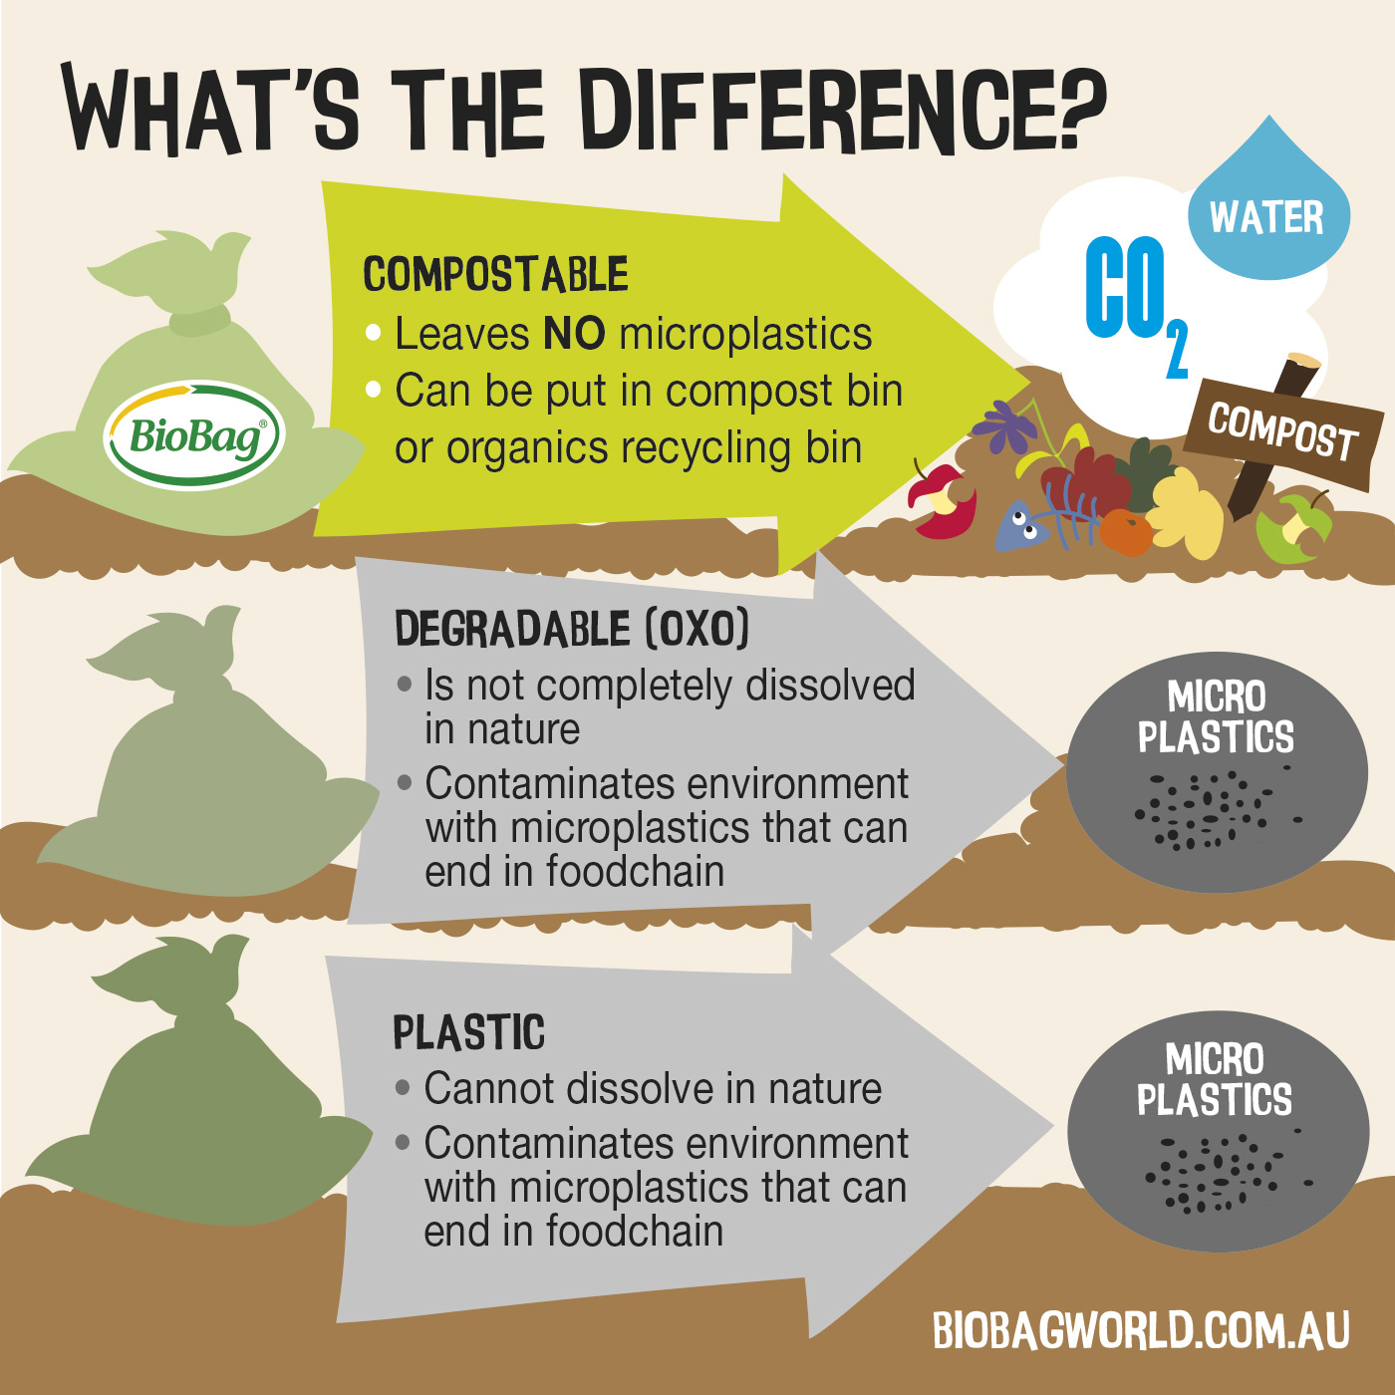
Notes:
oxo-degradable plastic means a material (however described) made of plastic which includes additives to accelerate the fragmentation of the material into smaller pieces, triggered by ultraviolet radiation or heat exposure, whether or not this is, or may be, followed by partial or complete breakdown of the material by microbial action;
SA govt definition

Slide 23
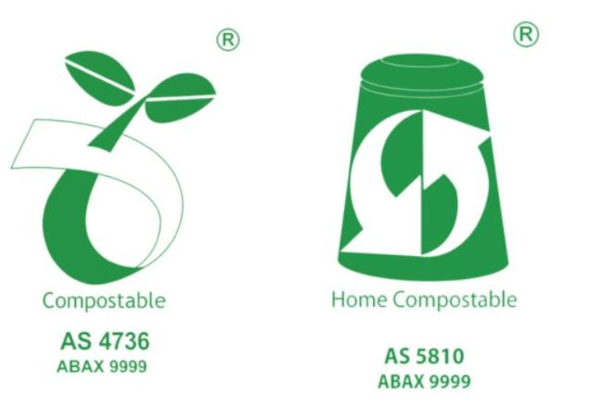
Compostible
Notes:
Similar to EN13432, ISO 107088 Astm D6400

Slide 24
Single Use Plastics
Banned: 1 March 2021
(a) a single-use plastic drinking straw;
(b) single-use plastic cutlery;
(c) a single-use plastic beverage stirrer;
Banned: 1 March 2022
(d) an expanded polystyrene cup;
(e) an expanded polystyrene bowl;
(f) an expanded polystyrene plate;
(g) an expanded polystyrene clamshell container;
Notes:
Promised to Look at:
(a) single-use plastic cups (including coffee cups);
(b) single-use plastic food containers;
(c) single-use plastic bowls;
(d) single-use plastic plates;
(e) plastic lids of single-use coffee cups;
(f) plastic balloon sticks;
(g) plastic balloon ties;
(h) plastic-stemmed cotton buds;
(i) plastic bags.

Slide 25
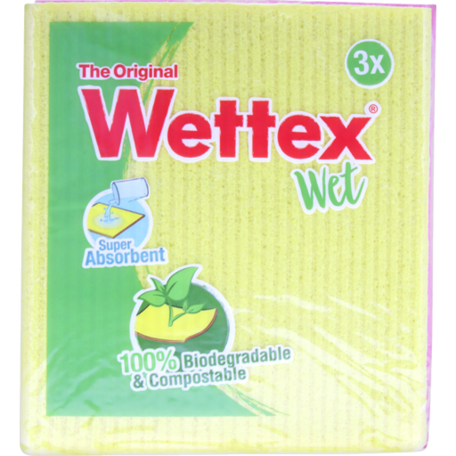
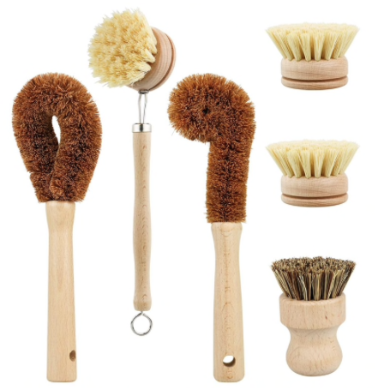
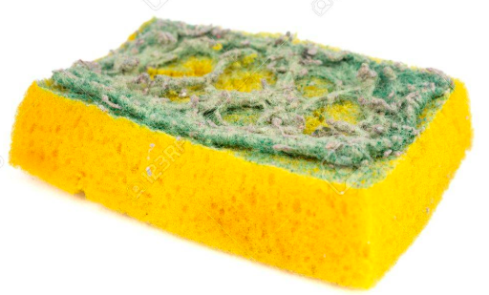
Plastic Alternatives - Kitchen Sponges
Swap this:
For this:
or
Notes:
Normal kitchen sponges are plastic
Wettex 100% compostable made out of Cotton & cellulose
Brushes are even better – mine lasted 2 + years
Many specialist websites & companies but also try Kmart & cheap stores

Slide 26
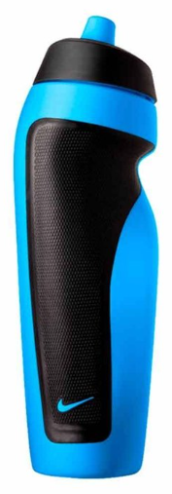
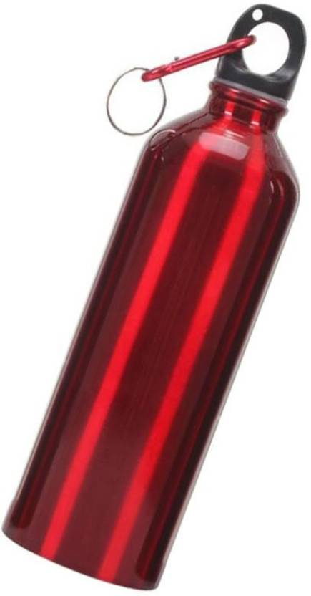
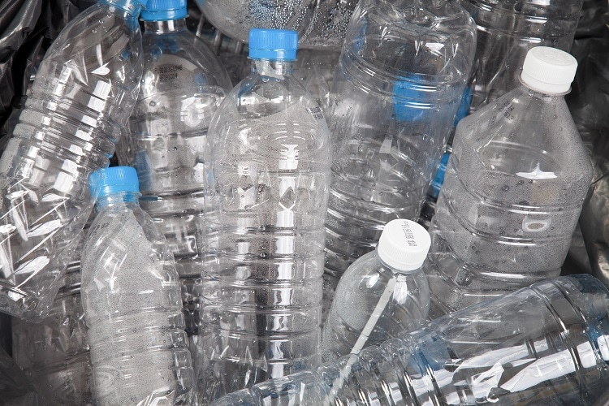
Plastic Alternatives – Water Bottles
Swap this:
For this: Or even better this:
Notes:
Bad (but could recycle): Disposable water bottles
Better: plastic refillable bottle
Best: Metal refillable bottle

Slide 27
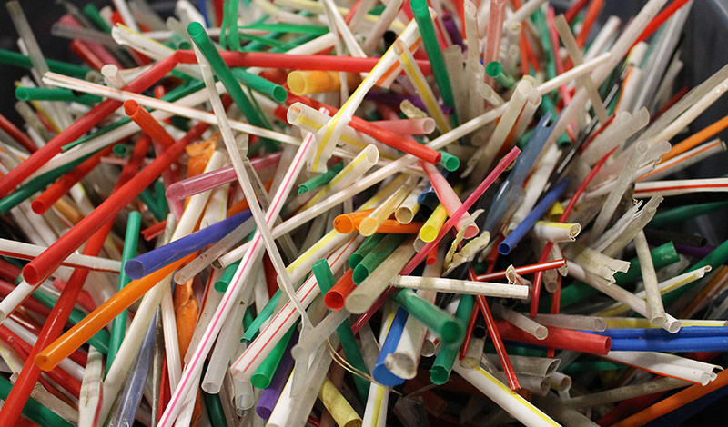
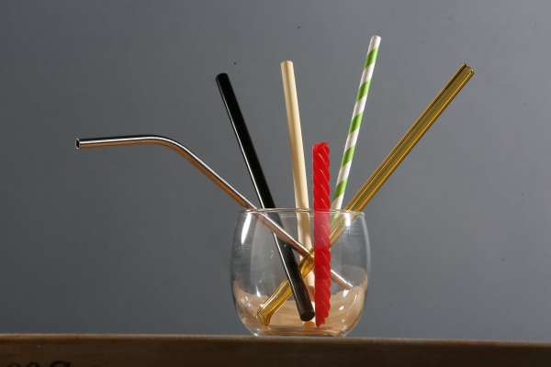
Plastic Alternatives - straws
Swap this:
For this:
Notes:
Plastic straws were banned in 2021 (before I first put this together)
No straw
Metal
Paper
Bamboo
Pasta
Silicone
Reusable straws

Slide 28
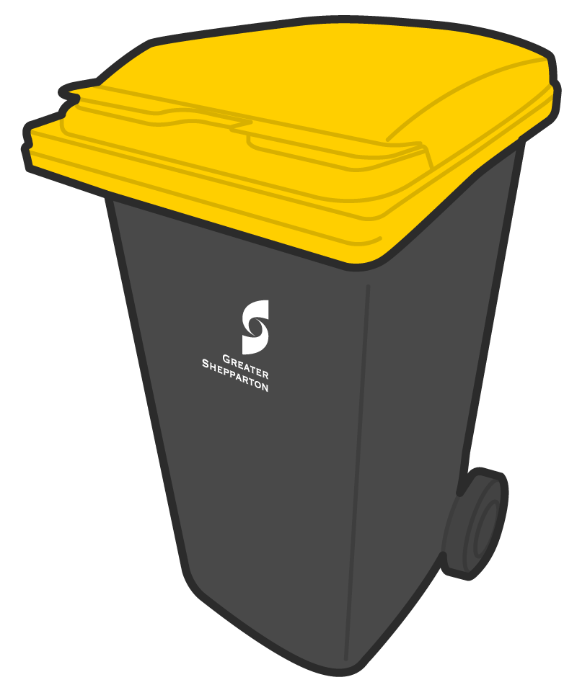
Recycling Plastics
Hard Plastics
At curbside
Soft Plastics
At supermarkets
Notes:
Hard Plastics into Yellow or Red lidded bin for recyclables – see your own council area for what can and can’t be included
Soft plastics – defined as anything without a defined shape
Recycled at supermarkets (Coles & Woolies) – see specific list for details

Slide 29
Redcycle
Notes:
Many do’s & Don’ts – do it well if you do it at all
You will be surprised by the amount of soft plastics you use
EPI bags are not recyclable

